Slide 1
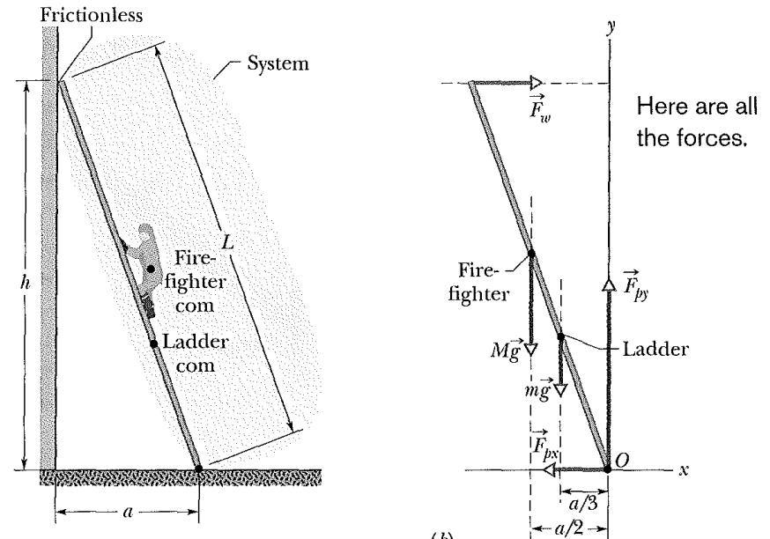
In Fig. 12-5a, a ladder of length L = 12 m and mass m = 45 kg leans against a slick wall (that is, there is no friction between the ladder and the wall). The ladder's upper end is at height h = 9.3 m above the pavement on which the lower end is supported (the pavement is not frictionless). The ladder's center of mass is L/3 from the lower end, along the length of the ladder. A firefighter of mass M = 72 kg climbs the ladder until her center of mass is L/2 from the lower end. What then are the magnitudes of the forces on the ladder from the wall and the pavement?

Slide 2
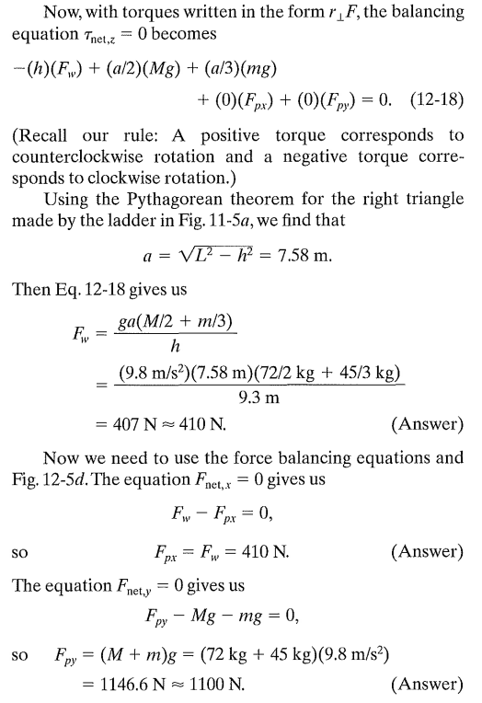

Slide 3
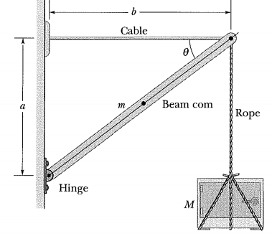
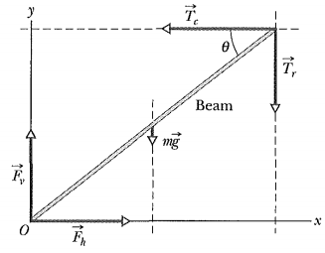
Figure shows a safe (mass M = 430 kg) hanging by a rope (negligible mass) from a boom (a = 1.9 m and b = 2.5 m) that consists of a uniform hinged beam (m = 85 kg) and horizontal cable (negligible mass).
(a) What is the tension Te in the cable? In other words, what is the magnitude of the force Te on the beam from the cable?
(b) Find the magnitude F of the net force on the beam from the hinge.

Slide 4
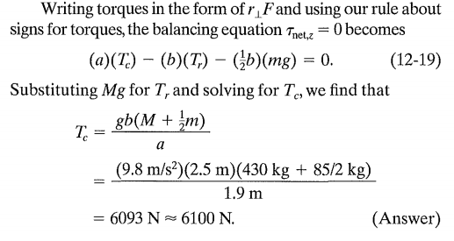
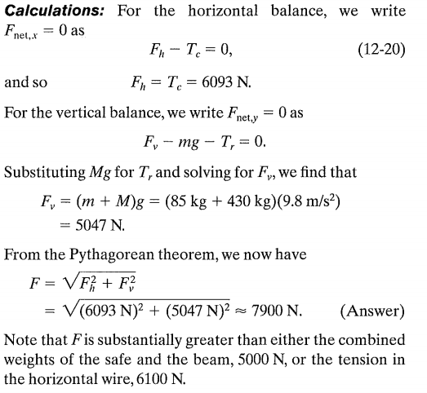

Slide 5
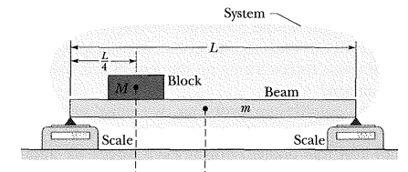
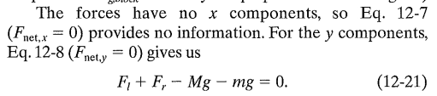
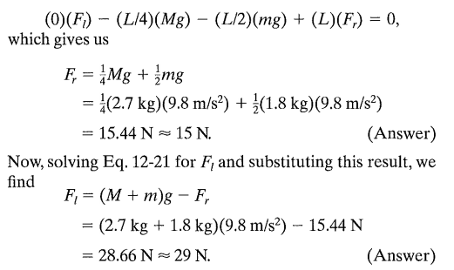
In Fig., a uniform beam, of length L and mass m = 1.8 kg, is at rest on two scales. A uniform block, with mass M = 2.7 kg, is at rest on the beam, with its center a distance L/4 from the beam's left end. What do the scales read?

Slide 6
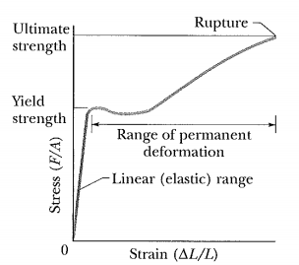

Slide 7
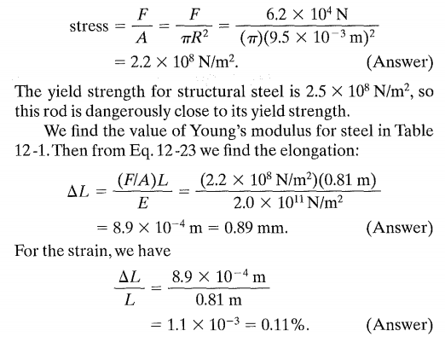
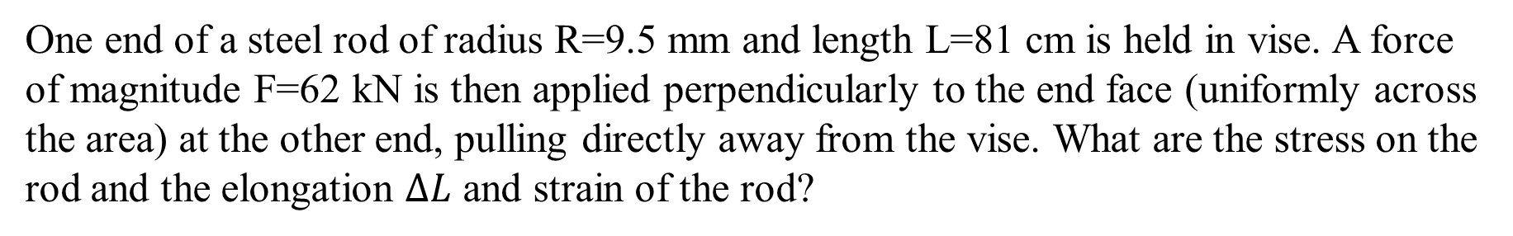
One end of a steel rod of radius R=9.5 mm and length L=81 cm is held in vise. A force of magnitude F=62 kN is then applied perpendicularly to the end face (uniformly across the area) at the other end, pulling directly away from the vise. What are the stress on the rod and the elongation $∆L$ and strain of the rod?

